Slide 1
Software Engineering
Requirements Analysis and Specification

Slide 2
Requirements Analysis and Specification
Many projects have failed:
  Because they started to implement the software.
  Without ever determining whether they are building what the customer really wanted.

Slide 3
What are Requirements?
A Requirement is:
  A capability or condition required from the system.
What is involved in requirements analysis and specification?
  Determine what is expected by the client from the system.
  Document them in the form that is clear to the client as well as to the development team members.

Slide 4
Activities in Requirements Analysis and Specification
Requirements Gathering
Requirements Analysis
Requirements Specification

Slide 5
Requirements Engineering Process
Feasibility
Study
Requirements
gathering
Requirements
analysis
Feasibility
report
Requirements
specification
SRS Document

Slide 6
Why requirements analysis?
Requirements: capabilities & conditions to which the system and the project must conform
Goals of this phase: fully understand requirements
  Gather requirements, constraints
  Analyze collected data to remove inconsistencies, etc
  Document requirements into Software Requirements Specification (SRS) document
Done by systems analysts
Notes:
Many projects fail because they start implementing the system without determining whether they are building what the customer really wants.
Reviewed SRS document forms the basis of all future development activities

Slide 7
Need for SRS…
Good SRS reduces development cost
  Req. errors are expensive to fix later
  Req. changes cost a lot (typically 40%)
  Good SRS can minimize changes and errors
  Substantial savings --- effort spent during req. saves multiple times that effort
An Example:
  Cost of fixing errors in req. , design , coding , acceptance testing and operation are 2 , 5 , 15 , 50 , 150 person-months
Cost

Slide 8
Requirement process..
needs
Specification itself may lead to more analysis
Validation can show gaps that can lead to further analysis and specification .
Gathering
Analysis
Specification
Validation
SRS Document

Slide 9
Requirements gathering
Analyst gathers requirements through
  Observing similar existing systems
  Discussion with customer / end-user / stake-holder
  BDD: Behavior driven development (*)
Easier if project is to automate some existing manual activity or a working system
  Otherwise lot of imagination and creativity are required
Requirements written down as user-stories
  Description of how system will be used by stake-holders
Notes:
BDD: asks questions about behavior of system before and during development to reduce miscommunication
If project is to automate some existing manual activity or a working system (e.g. accounting activity), the system analyst can immediately obtain required input / output formats, details of operational procedures involved, etc. In the absence of a working system, lot of imagination and creativity required
Properties of good system analyst: Good interaction skills, Imagination and creativity, experience.

Slide 10
Behavior driven development (BDD)
Behaviour Driven Development (BDD) is a synthesis and refinement of practices stemming from Test Driven Development (TDD) and Acceptance Test Driven Development (ATDD). BDD augments TDD and ATDD with the following tactics:
Apply the “Five Why’s” principle to each proposed user story, so that its purpose is clearly related to business outcomes
thinking “from the outside in”, in other words implement only those behaviors which contribute most directly to these business outcomes, so as to minimize waste
describe behaviors in a single notation which is directly accessible to domain experts, testers and developers, so as to improve communication
apply these techniques all the way down to the lowest levels of abstraction of the software, paying particular attention to the distribution of behavior, so that evolution remains cheap

Slide 11
Analysis of gathered requirements
Goal: detect Anomaly, incompleteness, inconsistencies
  Anomaly : Ambiguity in requirements
  Inconsistency: some part of the requirements contradicts some other part
  Incompleteness: some cases overlooked
Resolved through further discussion
Consider complexities that may arise while solving the problem

Slide 12
Requirement problem : Anomaly
Example-1 : When the temperature becomes high, the heater should be switched off
Example-2 : During the final attendance computation, if any student has sufficiently low count, then his/her parents will be called

Slide 13
Requirement problem : Inconsistency
Example :
  The furnace should be switched-off when the temp of the furnace raises above 500 C
  When the temperature of the furnace raises above 500C, the water shower should be switched on and furnace should remain on

Slide 14
Requirement problem : Incompleteness
Example :
  The temp of the furnace raises above 400 C then an alarm bell must be sounded
  no provision for resetting the alarm bell after the temp has been brought down in any of the requirements

Slide 15
Document requirements into SRS
SRS
  Written using end-user terminology (reviewed by user)
  black-box specification of system: only external behavior (input / output) documented
Importance of SRS
  Contract document with customer
  Reference document for design & development team
Challenge: make SRS understandable to different types of people
Notes:
SRS is very difficult to write because it must satisfy the needs of different people – cannot be too technical for customer, but has to give enough details for design / development team

Slide 16
Properties of good SRS document
Concise but not ambiguous or incomplete
Specify what the system must do, not how to do it
Well-structured, easy to change
Traceable
  Requirements Traceability Matrix (RTM): should be possible to trace which part of specification corresponds to which part of design, code, ... (& vice-versa)
Verifiable
  e.g. “system should be user friendly” is not verifiable

Slide 17
Contents of SRS document
Functional requirements
Non-functional requirements
Goals of implementation

Slide 18
Functional requirements
A system considered as a set of high-level functions or requirements
Each high-level function or requirement
  Users can do some useful piece of work through this
  E.g. search for a book in library
  May involve a series of interactions of system with user
  Described by specifying input data (from user), processing required and output data
  May consist of a set of sub-functions / sub-requirements
Notes:
Search for book in library:
Input: keywords (may ask which field to search e.g. title, author)
Output: details of books which match: title, author, reference number, ISBN, publisher, etc
Sub-function: if user selects a particular search result, show location of book in the library.
Even for the same high-level function, there can be different interaction sequences (or scenarios) due to users selecting different options or entering different data items.

Slide 19
Example functional requirements
Example: online library system
  Requirement 1: search for a book
  Requirement 2: renew borrowed book
R1: search for a book
  When user selects the “search” option
    He/she is asked to enter the key words
  System should output details of all books whose title or author name matches any of the key words entered
    Details: Title, Author Name, Publisher name, Year of Publication, ISBN Number, Catalog Number, Location in the Library

Slide 20
Example functional requirements
R2: renew borrowed book
  When the “renew” option is selected
    User asked to enter his membership id and password
  After id and password validation
    list of the books borrowed by him is displayed
  User can renew any of the books by clicking in the corresponding renew box

Slide 21
R1: search for a book
R1.1
  Input: ‘search’ option
  Output: user prompted to enter key words
R1.2
  Input: key words
  Output: Details of all books whose title or author name matches any of the key words
  Processing: search books list for the key words

Slide 22
R2: renew borrowed books
R2.1
  Input: ‘renew’ option selected
  Output: user prompted to enter membership id, password
R2.2
  Input: membership id and password
  Output:
    List of books borrowed by user displayed. User prompted to indicate books to be renewed, or
    User informed about bad password. Again prompt for id, passwd
  Processing: password validation; search for books borrowed by user and display

Slide 23
R2: renew borrowed books (contd.)
R2.3
  Input: user choice for renewal of the books issued to him
  Output: confirmation of the books renewed
  Processing: renew the books selected by user.

Slide 24
Non-functional Requirements
Characteristics of the system which can not be expressed as functions:
  Performance
  Maintainability
  Portability
  Usability
  Security
  Safety, etc.

Slide 25
Non-functional Requirements
Reliability issues :
Performance issues :
  Example: How fast the system can produce results
    so that it does not overload another system to which it supplies data, etc.
    Needs to be measurable (verifiability)
    Eg resp time should be xx 90% of the time

Slide 26
Design and Implementation Constraints
Hardware to be used,
Operating system or DBMS to be used
  Eg. Oracle DBMS needs to be used as this would facilitate easy interfacing with other applications that are already operational in the organization
Capabilities of I/O devices
Standards compliance
Data representations
  by the interfaced system

Slide 27
External Interface Requirements
User interfaces
Hardware interfaces
Software interfaces
Communications interfaces with other systems
File export formats

Slide 28
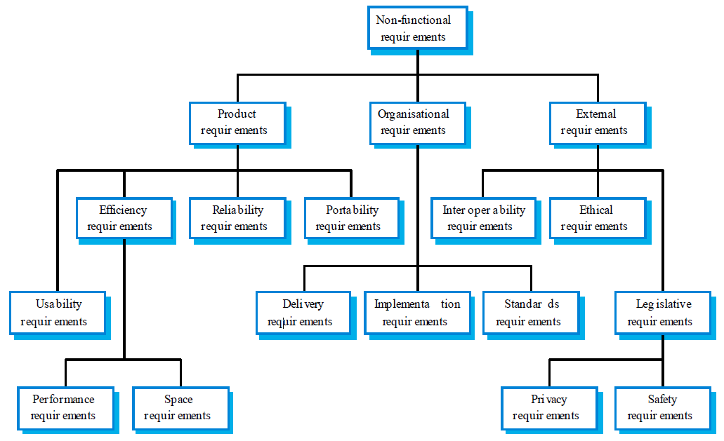
Non-functional requirement classification

Slide 29
Goals of implementation
Features that are desirable in the system, but would not be checked for compliance
Some general suggestions regarding development
  These suggestions guide trade-off among design goals
Portability, Reusability, Maintainability issues
Scope for functionalities to be developed in future
These are the items which the developers might keep in their mind during development

Slide 30
Representing complex processing logic
Decision trees - gives a graphic view of the processing logic involved in decision making and the corresponding actions taken
  Edges represent conditions
  Nodes represent actions to be performed

Slide 31
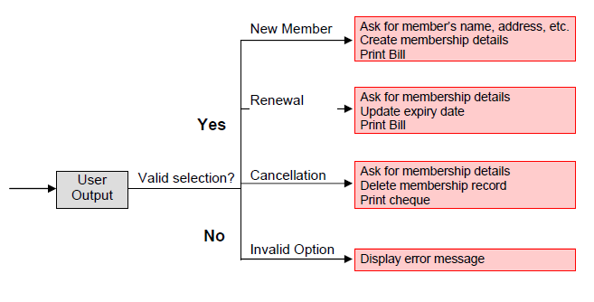

Decision tree example
Consider Library Membership Automation Software where it should support the following three options:
New member
Renewal
Cancel membership

Slide 32
Representing complex processing logic
Decision table - used to represent the complex processing logic in a tabular or a matrix form
  The upper rows of the table specify the conditions to be evaluated
  The lower rows of the table specify the actions to be taken when the corresponding conditions are satisfied.
  A column in a table is called a rule. A rule implies that if a condition combination is true, then the corresponding action is to be executed.

Slide 33
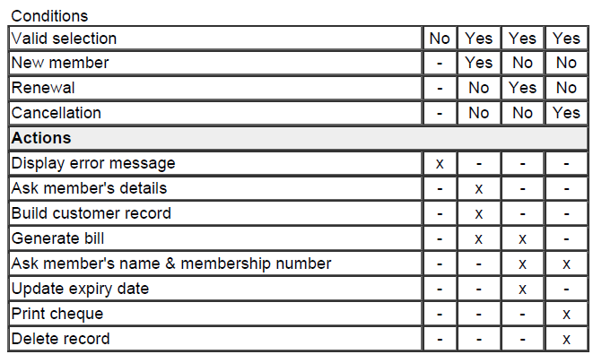
Decision Table example

Slide 34
Decision Table Vs Decision Tree
Both decision tables and decision trees
  Can represent complex program logic.
Decision trees are easier to read and understand
  When the number of conditions are small.
Decision tables help to look at every possible combination of conditions.

Slide 35
COMPUTER SYSTEMS ENGINEERING

Slide 36
Computer Systems Engineering
Encompasses software engineering
Many products require software as well as specific hardware to run the software
  High-level problem: decide which tasks are to be solved by software, which by hardware
  Often hardware and software developed together
  Hardware simulator used to test software
  Integration of hardware and software
  Final system testing

Slide 37
Computer Systems Engineering
Feasibility
Study
Requirements Analysis and Specification
Hardware Development
Hardware Software Partitioning
Software Development
Integration
and Testing
Project Management

